Slide 1
Marketing Operations in 2020
29th May 2020

Slide 2

Welcome to our association members

Slide 3
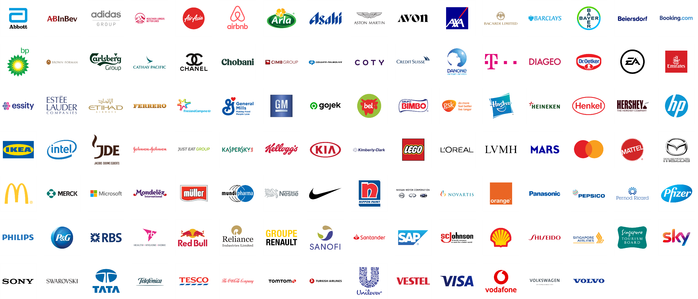


Our agenda based on your priorities

Slide 4
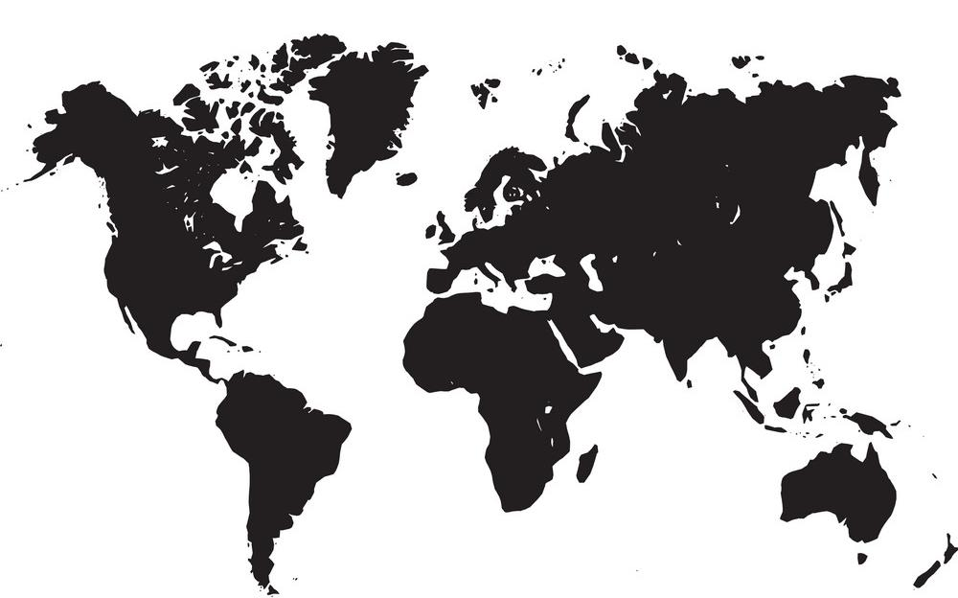
Global average* budgets down 36% FH, 31% FY
*Shows approximate weighted average estimates against our sample.
Q1: Looking at your first half (Q1&2) 2020 media budgets, how do you think these will be impacted? Q2: Looking at your overall (full year) 2020 media and marketing budgets…
Source: WFA Survey on Brands’ response to Covid-19 Crisis, April 22-28 2020; Base: 38 multinational companies in WFA membership

Slide 5


84% agree ‘this is an opportunity to rethink everything in terms of our marketing organisation’
Source: WFA Survey on Brands’ response to Covid-19 Crisis, April 22-28 2020; Base: 38 multinational companies in WFA membership

Slide 6
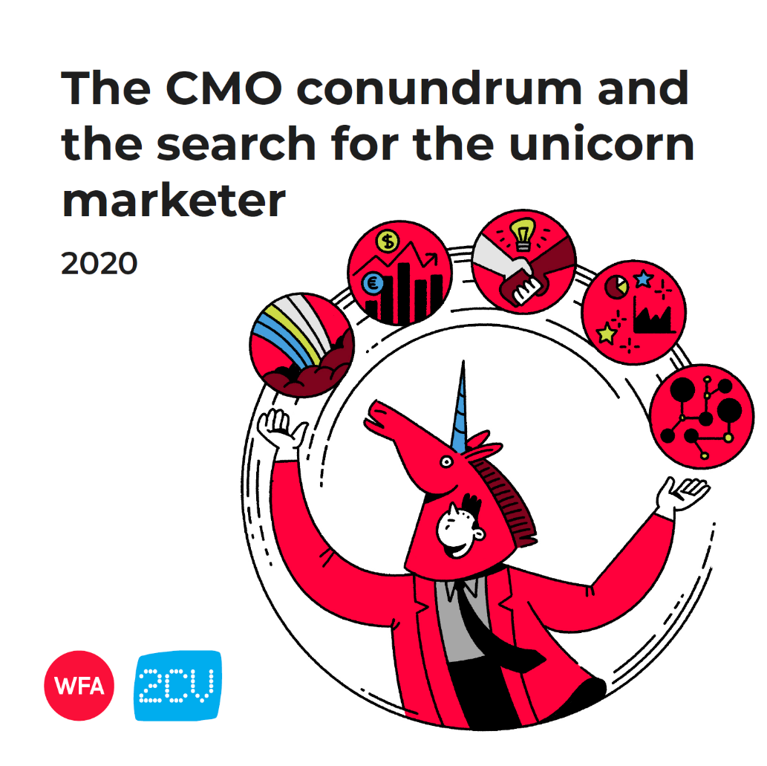
wfanet.org/motf

Slide 7


The search for the ‘unicorn marketer’
Ultimately, the ideal marketer is a ‘Da Vinci in aggregate’ – combining the strengths of both ‘left’ and ‘right-brained’ individuals into one, but as such probably doesn’t exist
Both data literate and creative
Possessing strong leadership skills and entrepreneurial
Experts in marketing, but with general business acumen
Technical and logical, whilst also empathetic and ethical
Diverse, inclusive and collaborative
Source: 2CV WFA 2020 research amongst 683 senior marketers in 31 markets
www.wfanet.org/motf

Slide 8

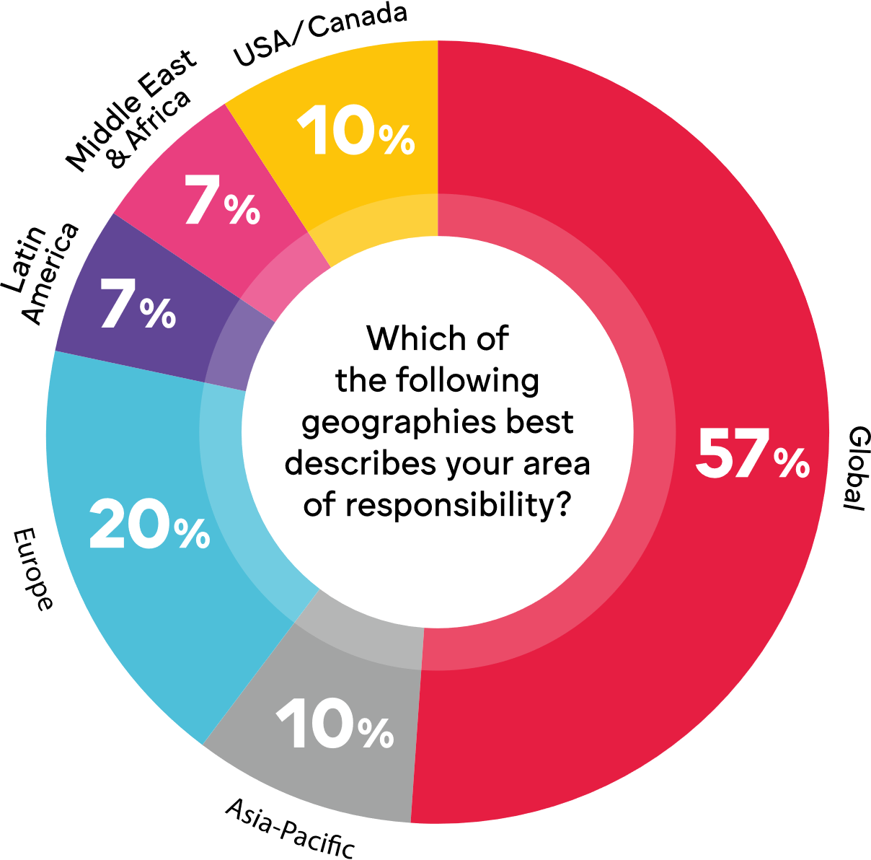
Wfanet.org/marketingoperations
Q: Which of the following geographies best describes your area of responsibility?
Source: WFA & Flock online survey March 2020. Base: 30 companies

Slide 9
Over to you…

Slide 10






Introductions
Robert Dreblow
Hanne van de Ven
Simon Francis
Florian Voigt
Head of Marketing Services
Events Manager
Chief Executive Officer
Marketing Consultant

Slide 11
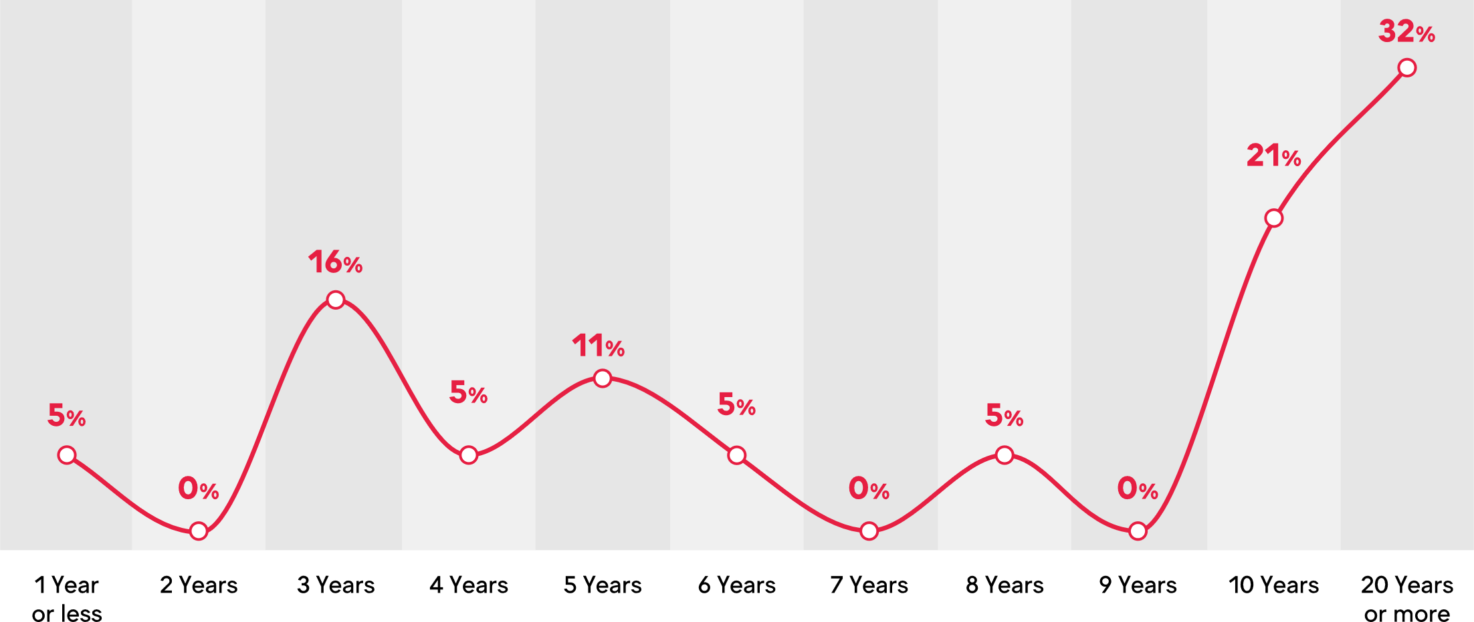

The average* marketing operations function is over 10 years old
Q: If you have a marketing operations function in your organisation, how established is it?
Source: WFA & Flock online survey March 2020. Base: 30 companies
*approximated weighted average based on our sample

Slide 12
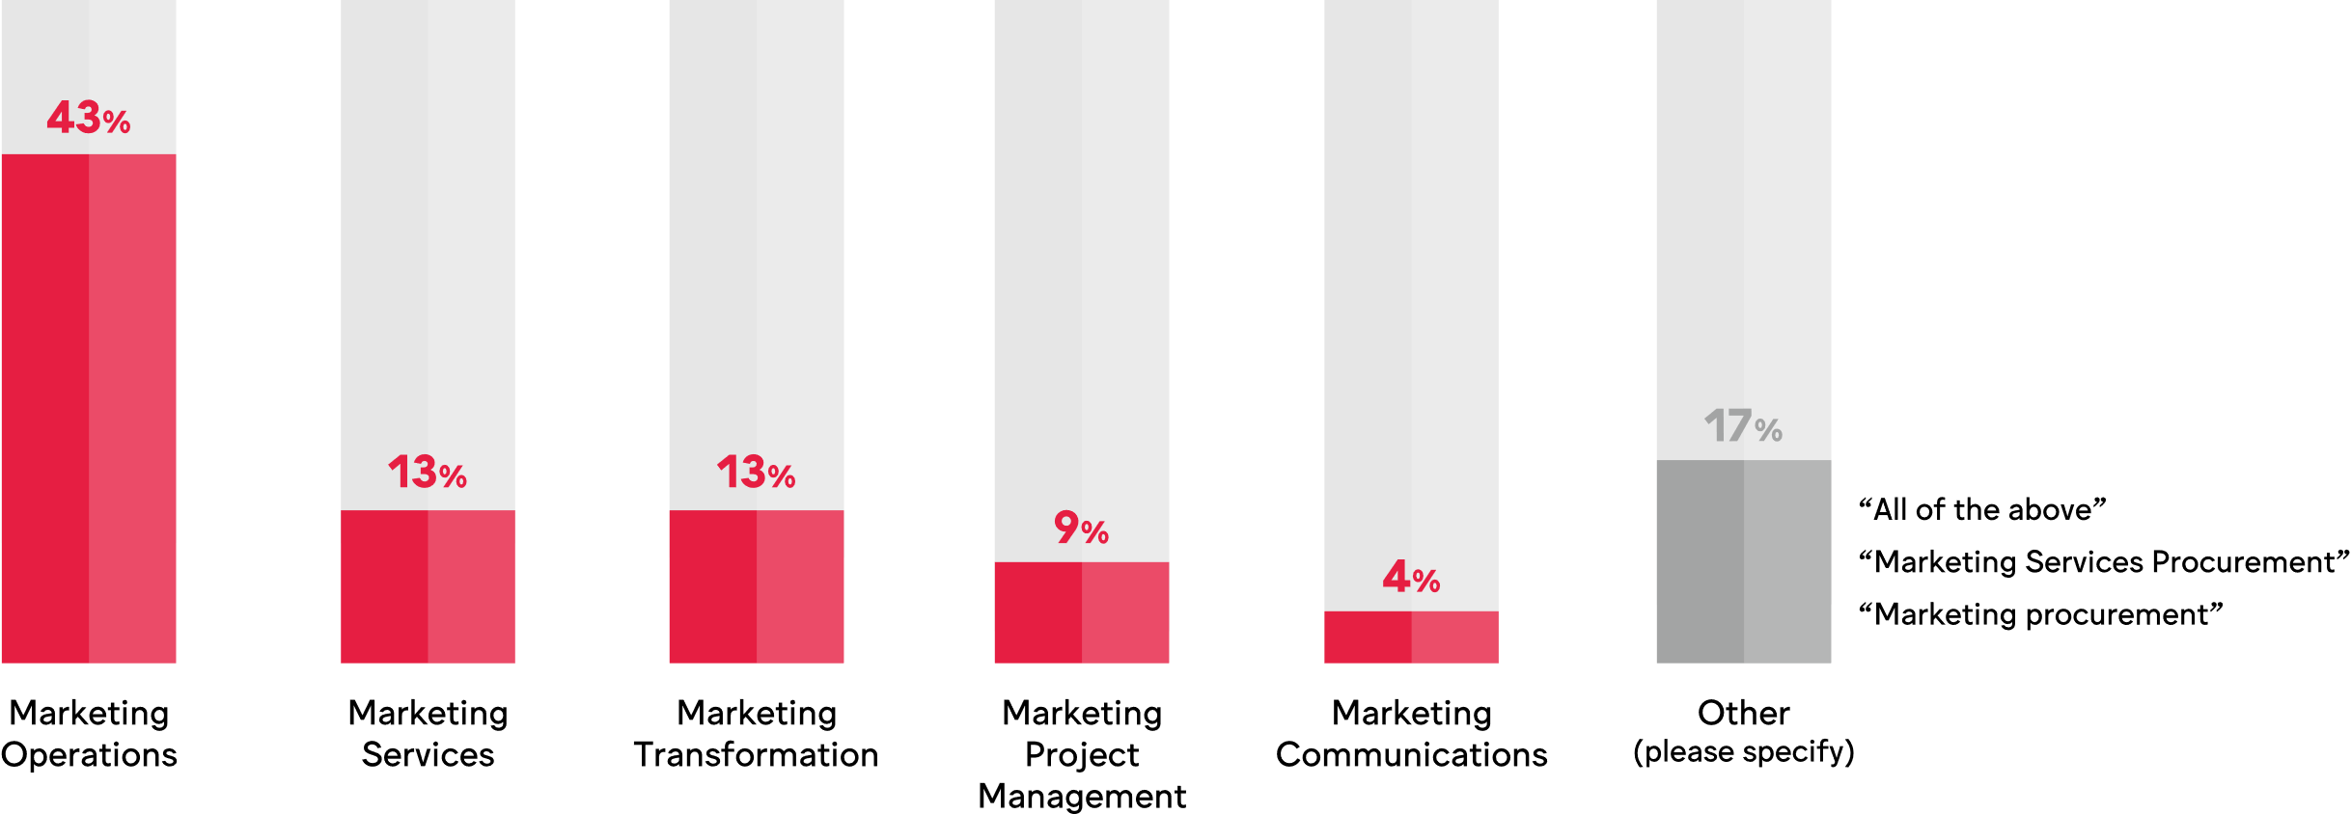
73% have a marketing operations function within their organisation. Respondents’ roles defined as…
Q: Which of the following roles best describes your function within your organisation?
Source: WFA & Flock online survey March 2020. Base: 30 companies

Slide 13
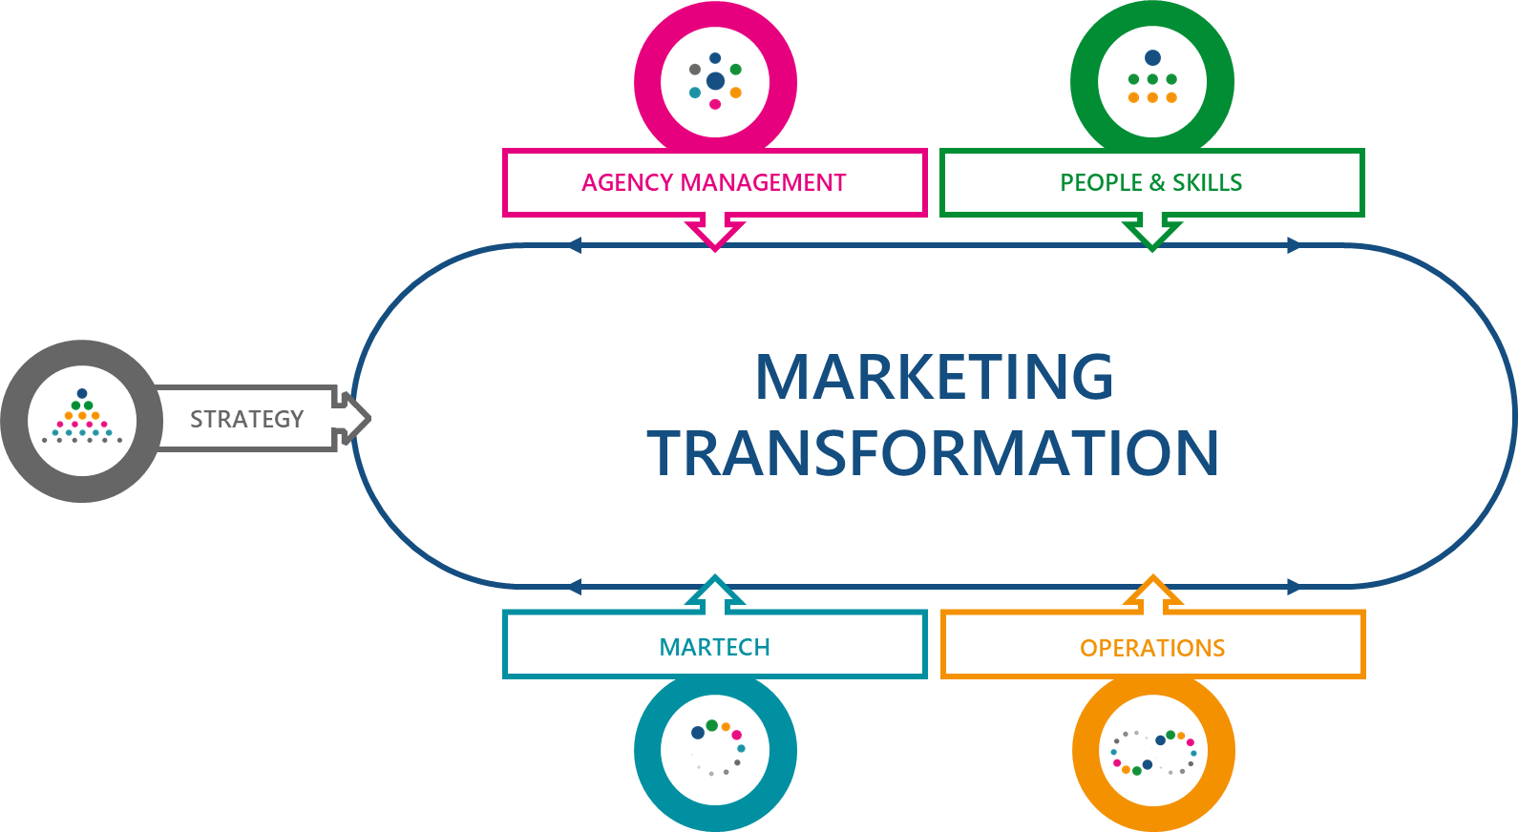
Marketing Operations & Marketing Transformation

Slide 14
Different reasons for not having a marketing operations function…
It’s coming… “We are currently transforming our marketing & are looking at it for the future” “One for the future” | Someone else does it… “It’s not a discrete function but part of the overall marketing team” “Operations are managed by brand management and market activations”
Not for us “We have a traditional (field) marketing setup” | Not sure “I don’t think it’s a conscious decision… In some markets we have marketing services function that could be considered as marketing operations but it's rather the exception than the norm.”
Q: Could you please share, in a short sentence, why you do not have a marketing operations function?
Source: WFA & Flock online survey March 2020. Base: 30 companies

Slide 15

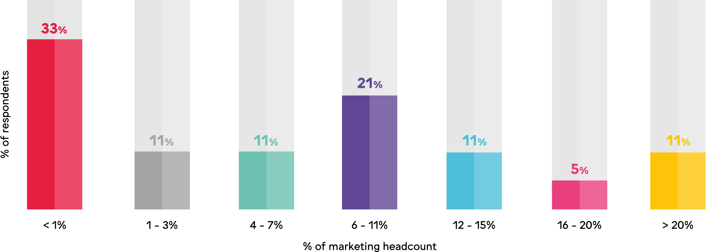
On average* the marketing operations team represents 8% of marketing’s headcount
Q: Approximately what % of your total marketing team headcount does marketing operations represent?
*Approximated weighted average based on our sample
Source: WFA & Flock online survey March 2020. Base: 30 companies

Slide 16
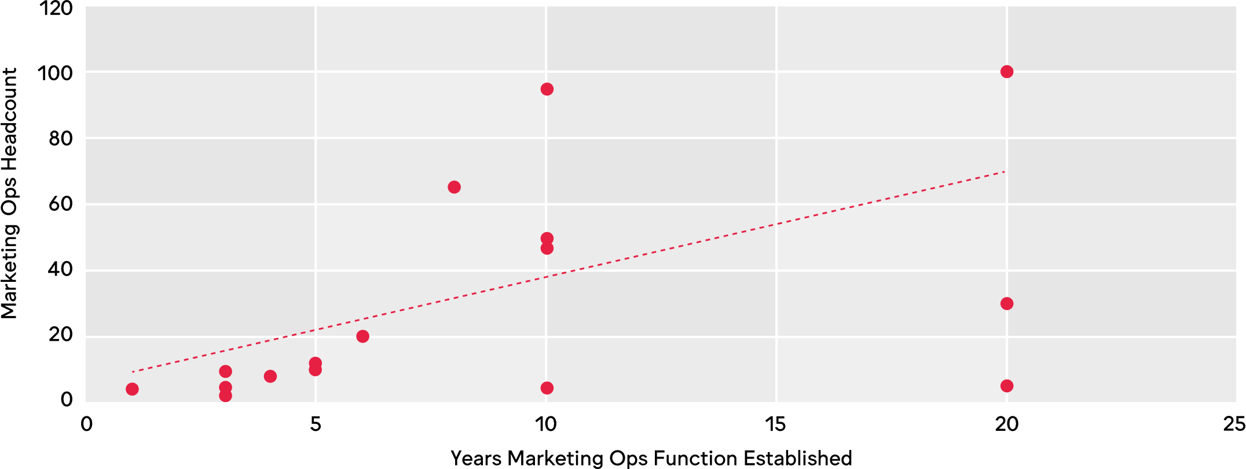
As the team matures, the headcount rises
Q: How many people work in your marketing operations department? (plotted against how many years the team has been established)
Source: WFA & Flock online survey March 2020. Resp: 19 companies

Slide 17

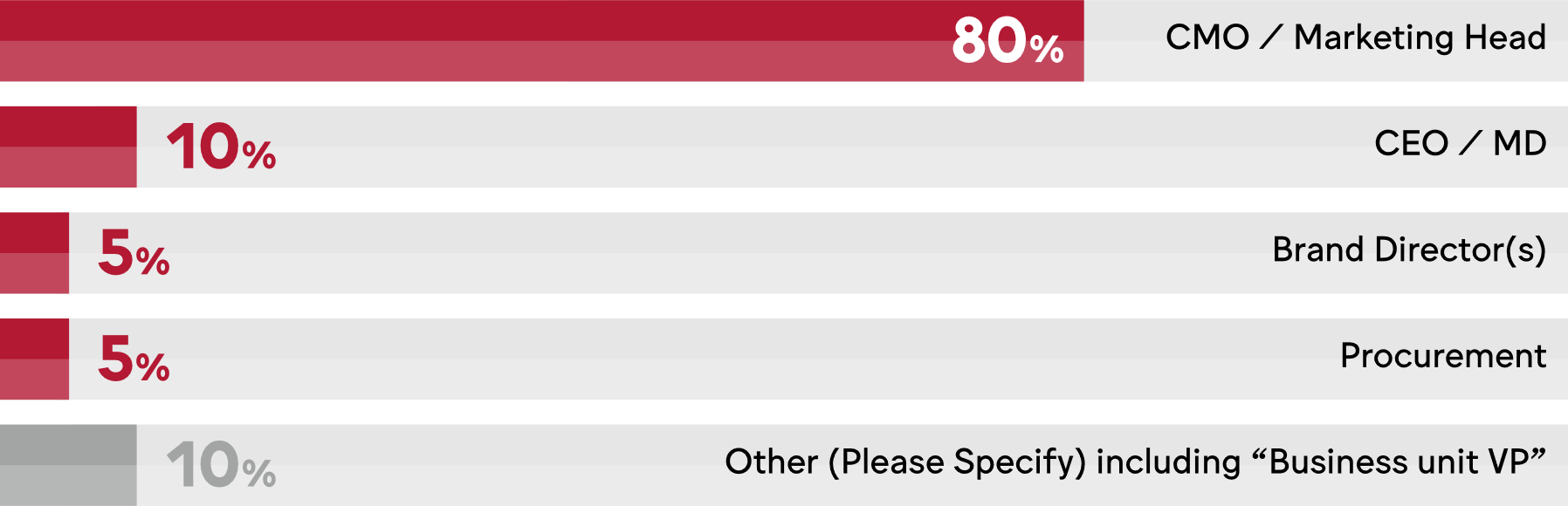
Majority report to CMO.
Q: Who does marketing operations report to in your organisation?
Source: WFA & Flock online survey March 2020. Base: 30 companies

Slide 18
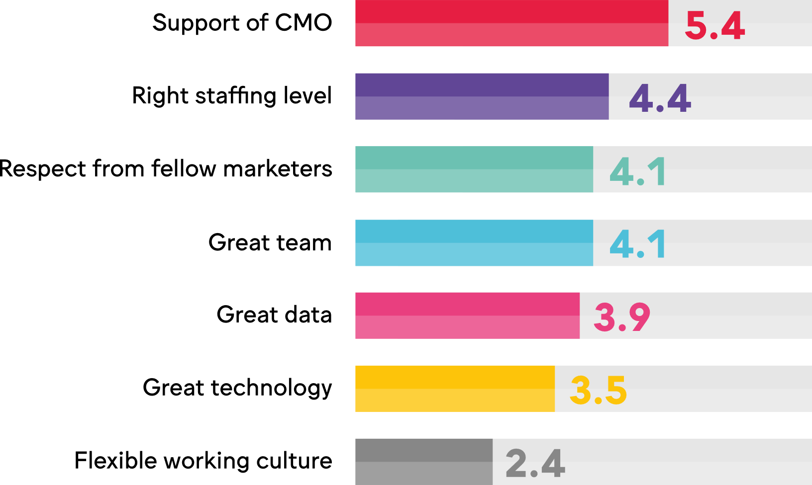
Meaning their support is critical...
Weighted average ranking / 7
Q: What do you believe are the critical enablers for a successful marketing operations team? Please rank by priority (highest priority first)
Source: WFA & Flock online survey March 2020. Base: 30 companies

Slide 19
Many critical roles for marketing ops
Q: Which of the following are included within your marketing operations remit and, if applicable, please rate their relative importance.
Source: WFA & Flock online survey March 2020. Base: 20 companies

Slide 20
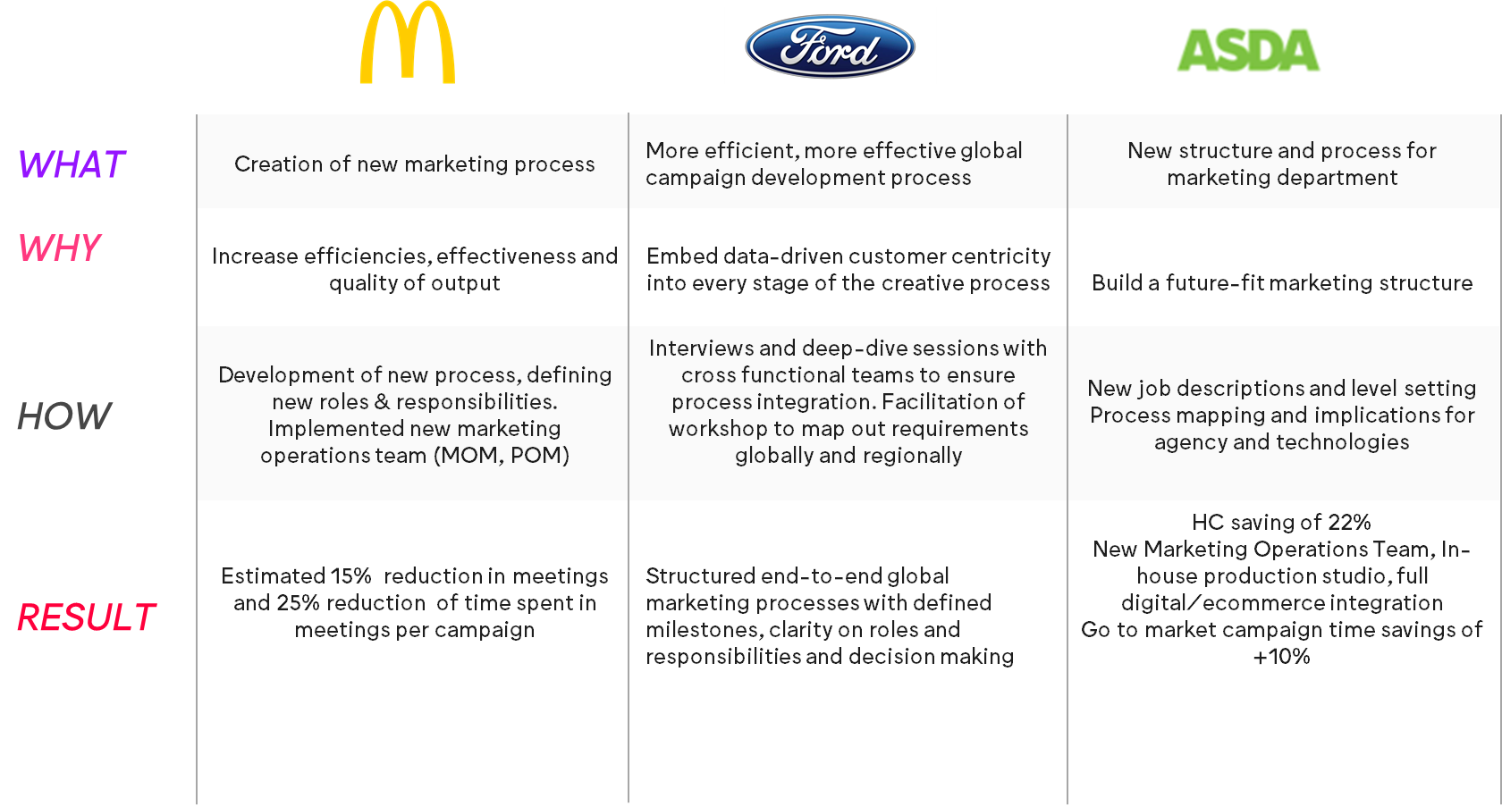
Flock role in supporting MOPS

Slide 21
Leadership expect marketing operations “to deliver results”
“
Leading planning, agency management and capability training
The glue between our siloed organization
To enable the function to operate effectively
To create an end to end ecosystem by developing team digital capabilities and using technology to increase marketing ROI and reporting capabilities.
Enable marketing effectiveness and efficiency
Deliver best in class marketing capabilities for all the brands - best effectiveness at best cost.
Q: Please share your senior leadership’s expectations relating to the role of marketing operations?
Source: WFA & Flock online survey March 2020. Base: 30 companies
Note: above shows a sample of responses

Slide 22
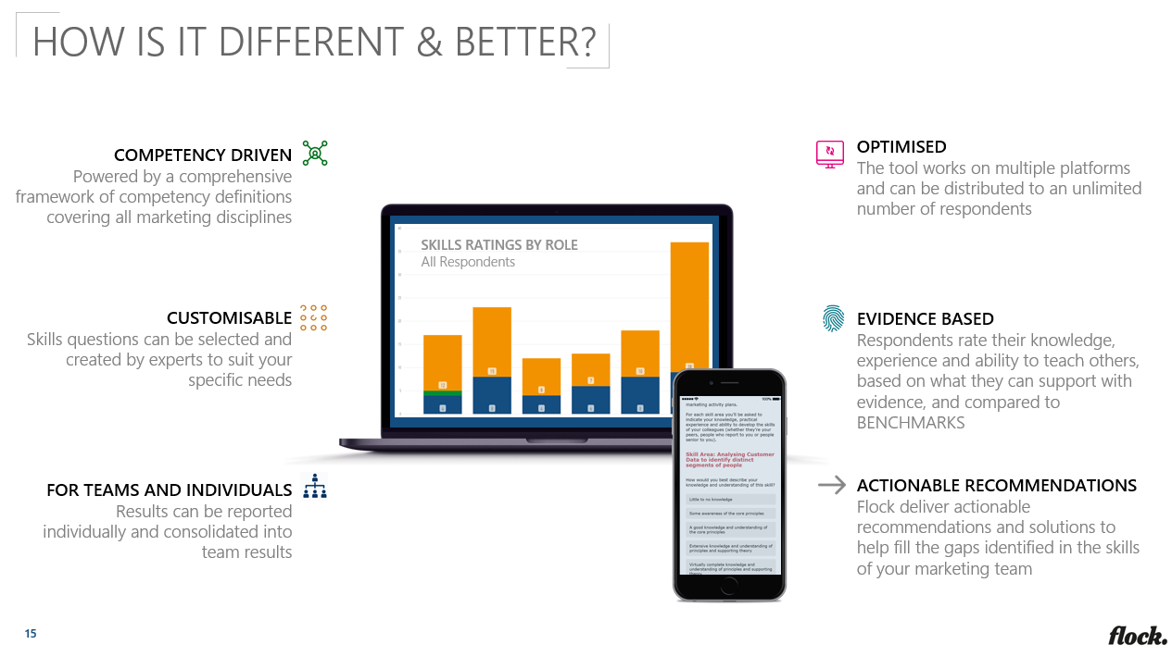



Skills Assessment Tool

Slide 23
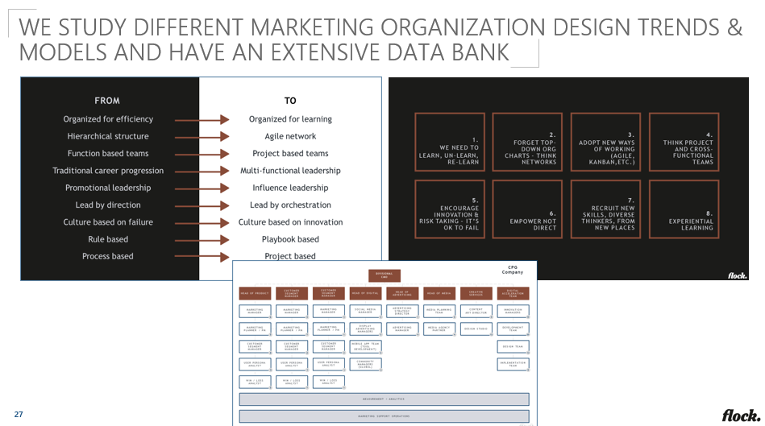
Organisation design and process

Slide 24
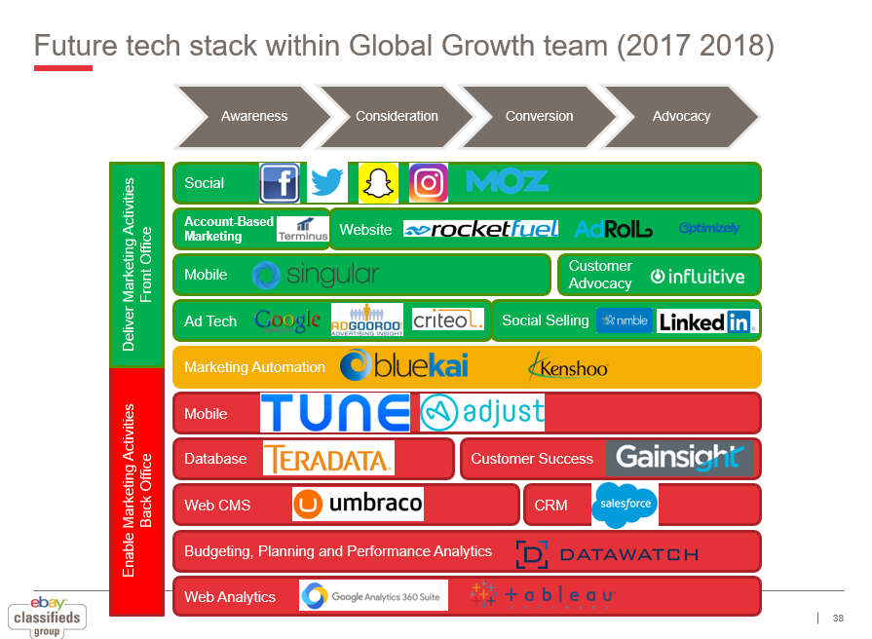
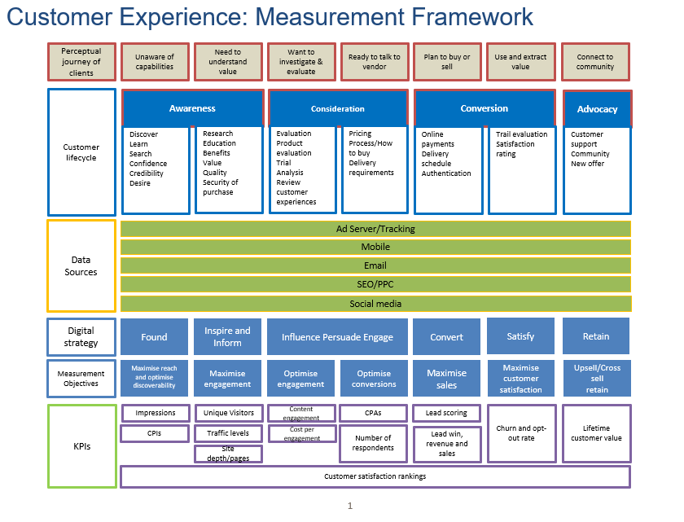
Martech & Data stack design
Data changed for confidentiality purposes

Slide 25
Poll

Slide 26

Challenges facing the function
External agency ecosystem “The digital evolution and complexity of the ecosystem ( agency, publishers, martech, OTT, GAFA) and the customer interest and attention" | Internal organisation “Internal challenges around alignment across a decentralized organization more for less"
Data and tech “The pace of change is so large … GDPR, Tech stack, multiple brands... | Legacy approaches “Agile planning and execution within long, established campaigns"

Slide 27

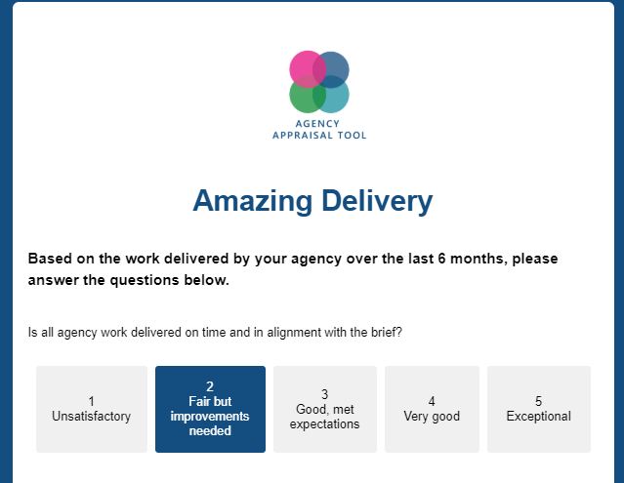


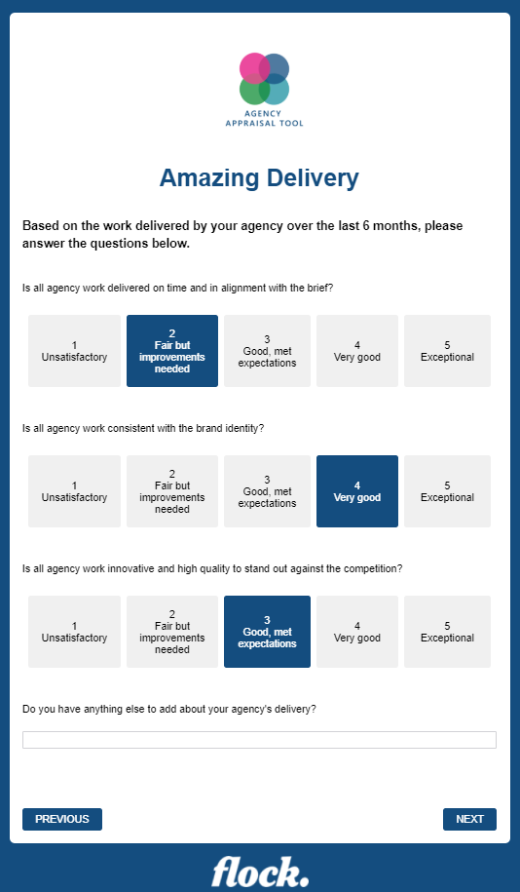

Agency Appraisal & Scoping Tool
360º REVIEW
Client on Agency, Agency on Client, Agency on Agency and Agency
Self Appraisal
OPTIMISED
The tool works on multiple platforms and can be distributed to an unlimited number of respondents
TAILORED QUESTIONS
Questions created by experts that are tailored to suit your specific needs
LINKED
The tool questions, layout and report can be linked to remuneration models/bonus
RICH DATA
Delivers both qualitative and quantitative data in a live dashboard, benchmarking against industry standards
ACTIONABLE RECOMMENDATIONS
Flock deliver actionable recommendations and solutions to help fill the gaps identified in your client and agency relationship

Slide 28
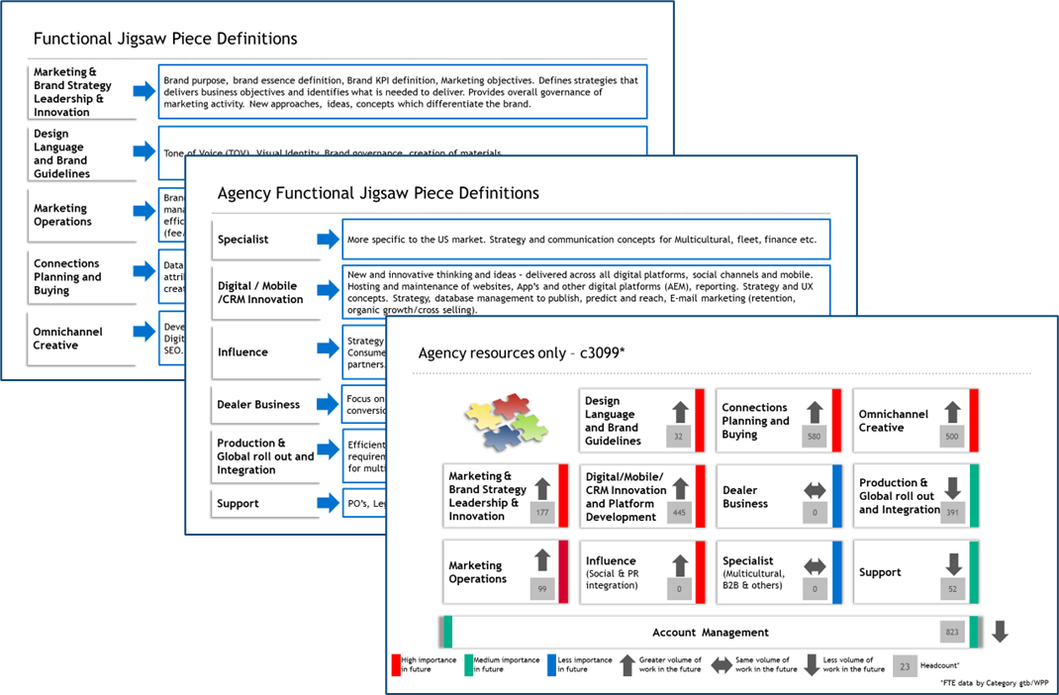
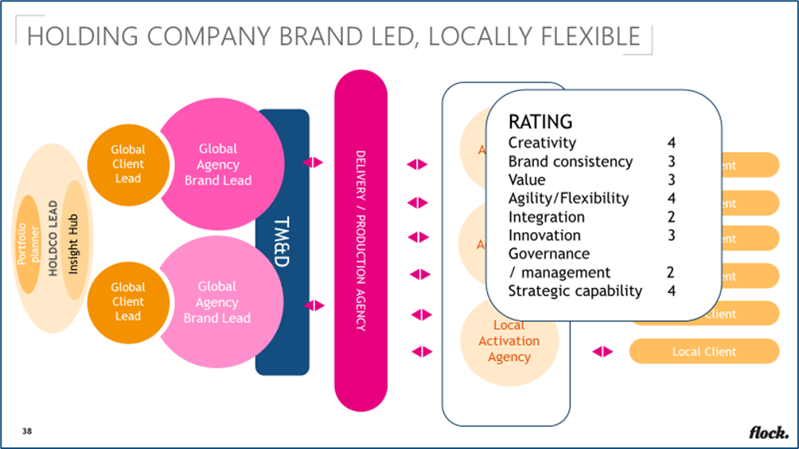
Ecosystem reviews

Slide 29
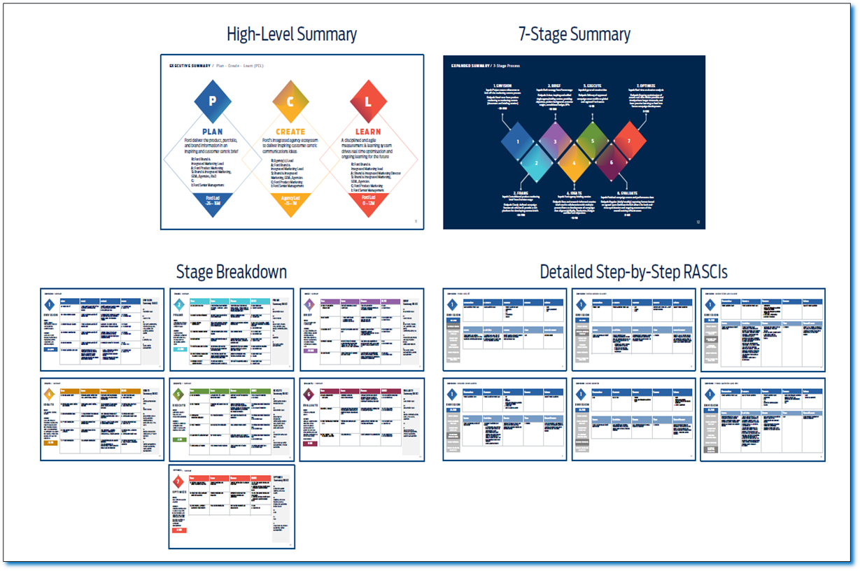

Agile process implementation

Slide 30
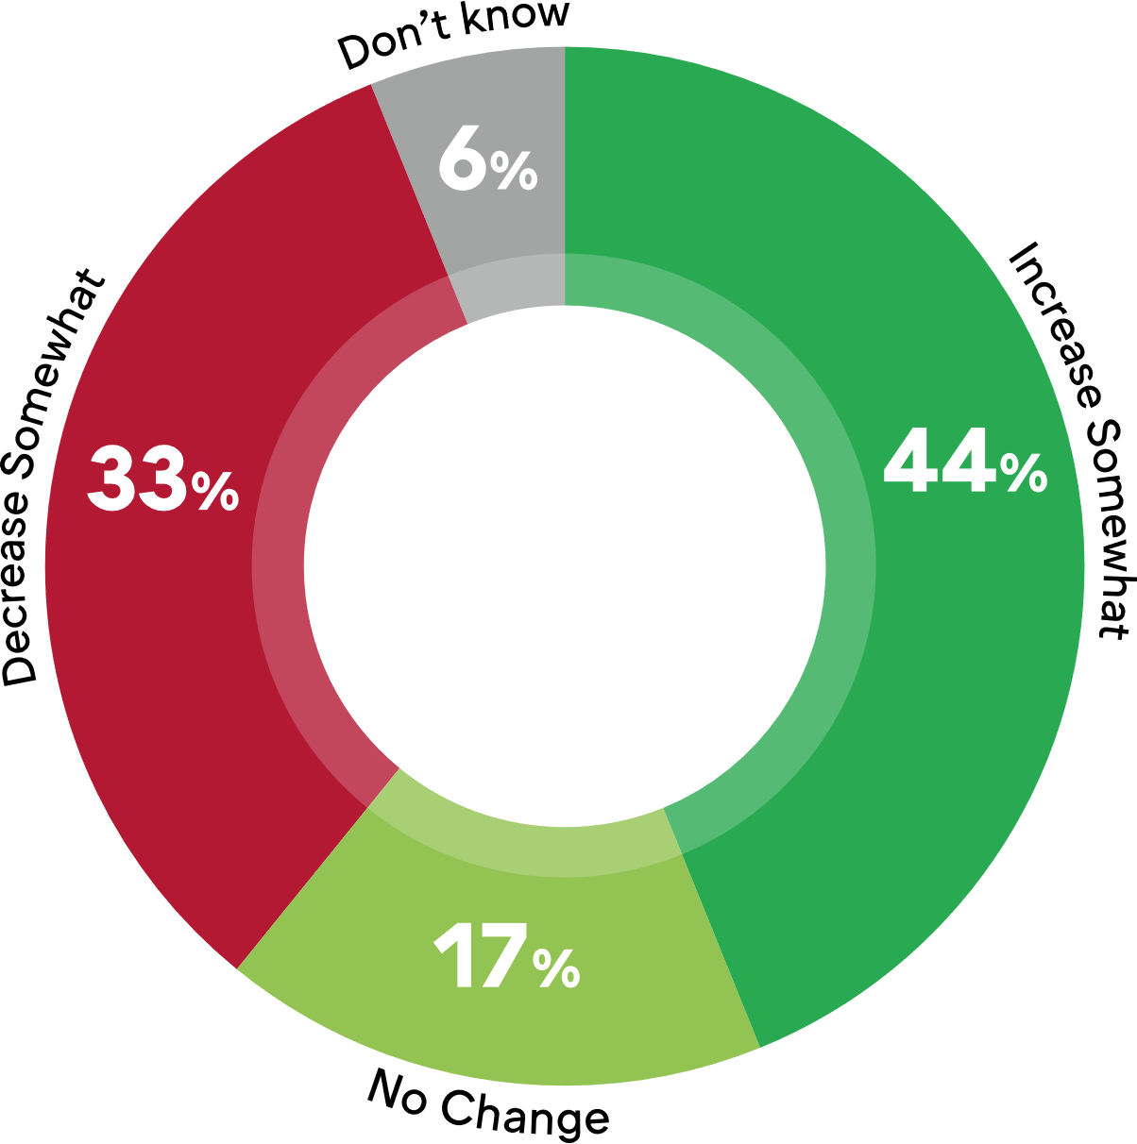
Future investment curve fairly flat
Q: Do you expect to increase investment in marketing operations over the next 3 years?
Source: WFA & Flock online survey March 2020. Base: 30 companies. Note: no respondents said ‘decrease significantly or ‘increase significantly’

Slide 31
Flock’s top tips for marketing operations
Processes
Standardisation data & technology
Skills Assessment
People & Organisation
Agency ecosystem

Slide 32
wfanet.org/marketingoperations
Simon Francis,
simon.francis@flock-associates.com
Florian Voigt,
florian.voigt@flock-associates.com
Robert Dreblow,
r.dreblow@wfanet.org
Q: Which of the following geographies best describes your area of responsibility?
Source: WFA & Flock online survey March 2020. Base: 30 companies

