Slide 1

Marketing Operations
Survey Results
In partnership with
May 2020

Slide 2
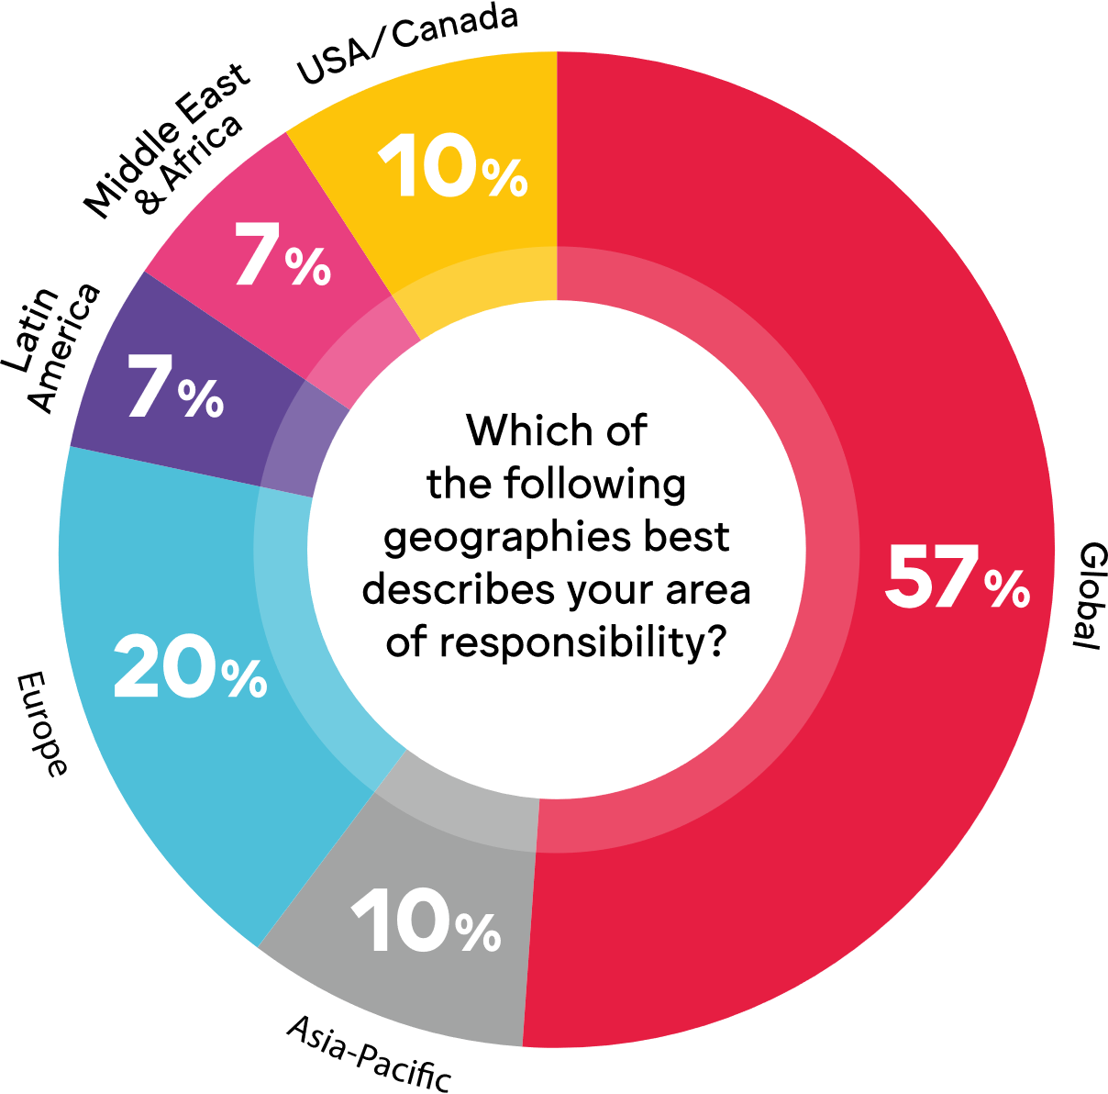
About this document
This document provides an overview of results of a study into marketing operations amongst WFA members;
The survey was run in March 2020;
Individuals from 30 companies took part with 43% spending over US$1bn PA;
In total the sample represented approx. US$21bn in marketing investment;
All respondents had global or regional responsibilities (see right).
Q: Which of the following geographies best describes your area of responsibility?
Source: WFA & Flock online survey March 2020. Base: 30 companies

Slide 3
Executive Summary
The marketing operations function is clearly established in marketing organisations (73% have a marketing operations function within their organisation) and still growing in importance.
Responsibilities are shifting to a more strategic role: leading the marketing performance element of organisations as well as having a strong influence in marketing strategy and capability planning to ensure the marketing department is fit for the future.
In our fast changing marketing environment, a close relationship with the CMO (over 50% of the Marketing Operations leaders are reporting into the CMO), and the leadership support of the CMO, ensures that business targets are hit and the quality of marketing output is improved.
Agency management, including KPI setting and tracking, alongside more effective processes, budget control, as well as implementing new technologies and tools are all part of today's responsibilities for marketing operations teams.
Legacy processes and behaviour, siloed thinking and organisational design, plus the changing agency landscape with data & technology becoming more and more the key driver for change, are all challenges for the marketing operations function.

Slide 4
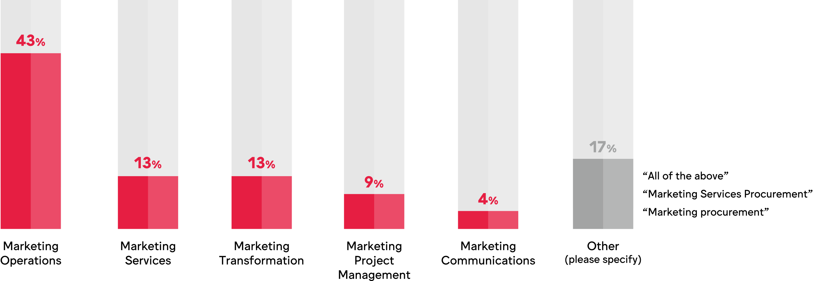
73% have a marketing operations function within their organisation. Respondents’ roles defined as…
Q: Which of the following roles best describes your function within your organisation?
Source: WFA & Flock online survey March 2020. Base: 30 companies
Notes:
There are different ways to describe this role; but in the last couple of years there has been a trend towards clearly labelling marketing operations as such and developing it into an integral team to support the CMO and to unify internal marketing teams.

Slide 5
Different reasons for not having a marketing operations function…
It’s coming… “We are currently transforming our marketing & are looking at it for the future” “One for the future” | Someone else does it… “It’s not a discrete function but part of the overall marketing team” “Operations are managed by brand management and market activations”
Not for us “We have a traditional (field) marketing setup” | Not sure “I don’t think it’s a conscious decision… In some markets we have marketing services function that could be considered as marketing operations but it's rather the exception than the norm.”
Q: Could you please share, in a short sentence, why you do not have a marketing operations function?
Source: WFA & Flock online survey March 2020. Base: 30 companies
Notes:
However, there are exceptions. Often there is a need for a marketing operations structure and team to be implemented - but not enough time, budget or expertise to set it up properly.
As this requires some investment, the business plan needs to be well thought through and a ROI clearly established to justify the investment

Slide 6
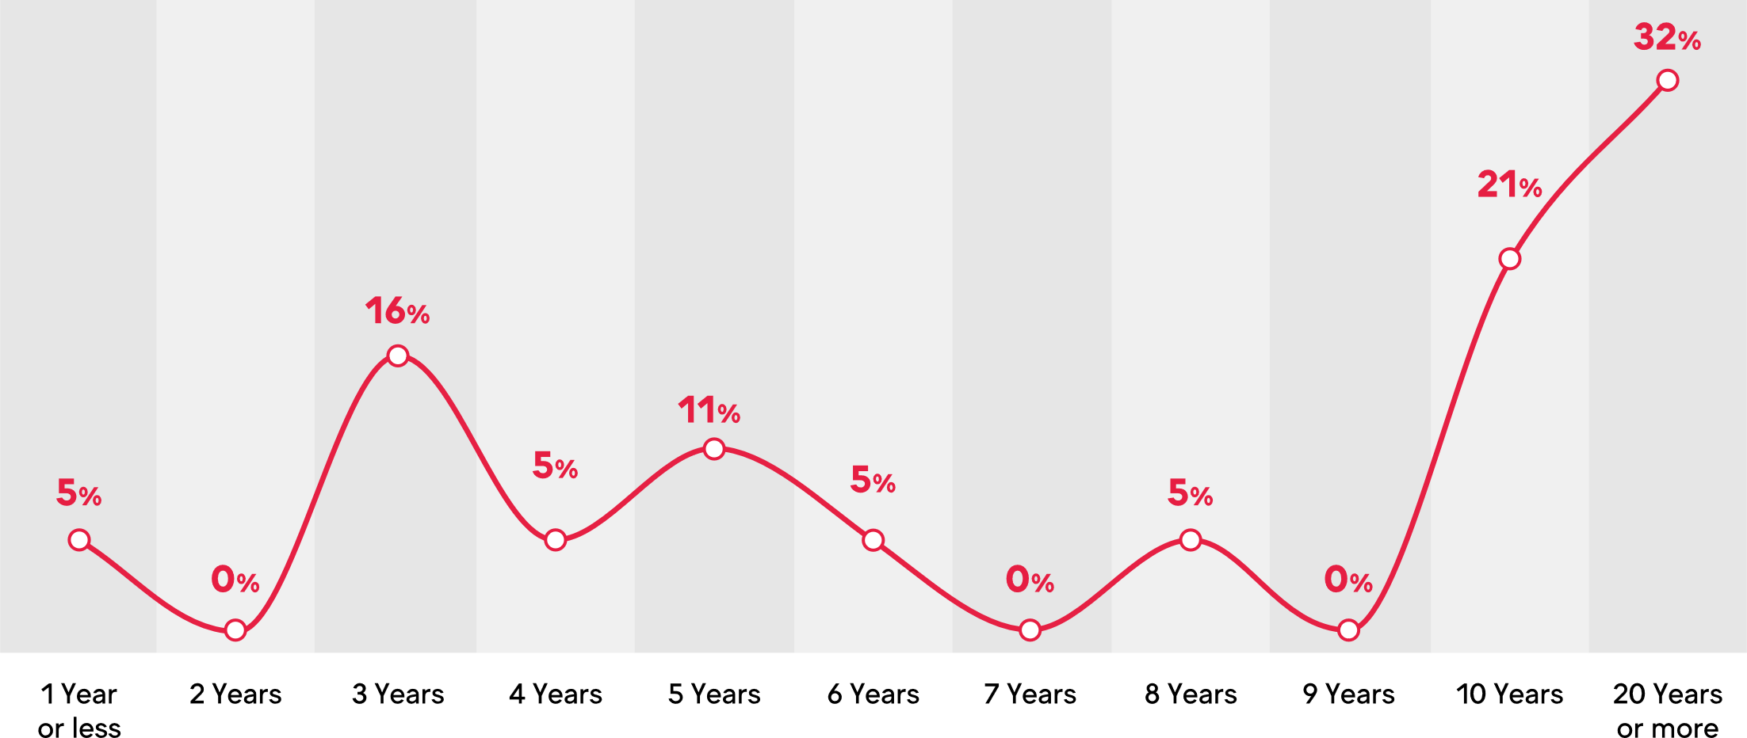

The average* marketing operations function is over 10 years old
Q: If you have a marketing operations function in your organisation, how established is it?
Source: WFA & Flock online survey March 2020. Base: 30 companies
*approximated weighted average based on our sample
Notes:
Marketing operations is clearly not a new thing. It has been around for years – however, in the last few years, it has seen a rise in its importance.
Twenty years ago, marketing operations was focused much more in consumer research. But, with the increase in use of technology and tools, marketing operations has taken a massive shift towards software based solutions with the purpose to increase efficiency and drive agility within an ever-changing environment.

Slide 7
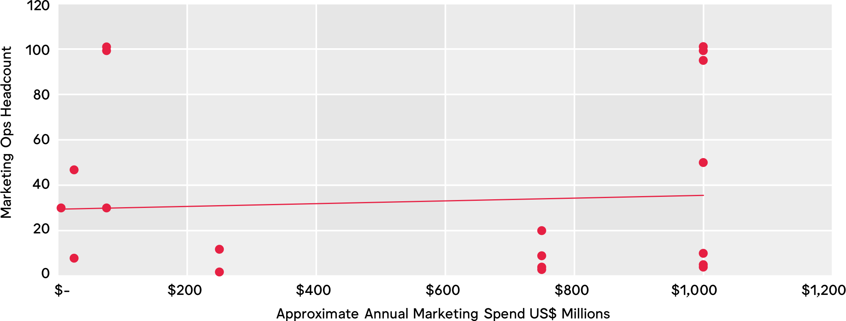
Average* of 35 people in marketing ops team. No clear trend in headcount versus spend, but some outliers.
Q: How many people work in your marketing operations department? (plotted against marketing investment bracket averaged out)
*Approximated weighted average based on our sample
Source: WFA & Flock online survey March 2020. Resp: 19 companies
Notes:
Team size is often not related to spend, but more so to complexity. A company with many divisions, brands, products and a complex route to market may require many more (and differently skilled) Marketing Operations team members, than a simpler structure – Irrespective of marketing spend

Slide 8

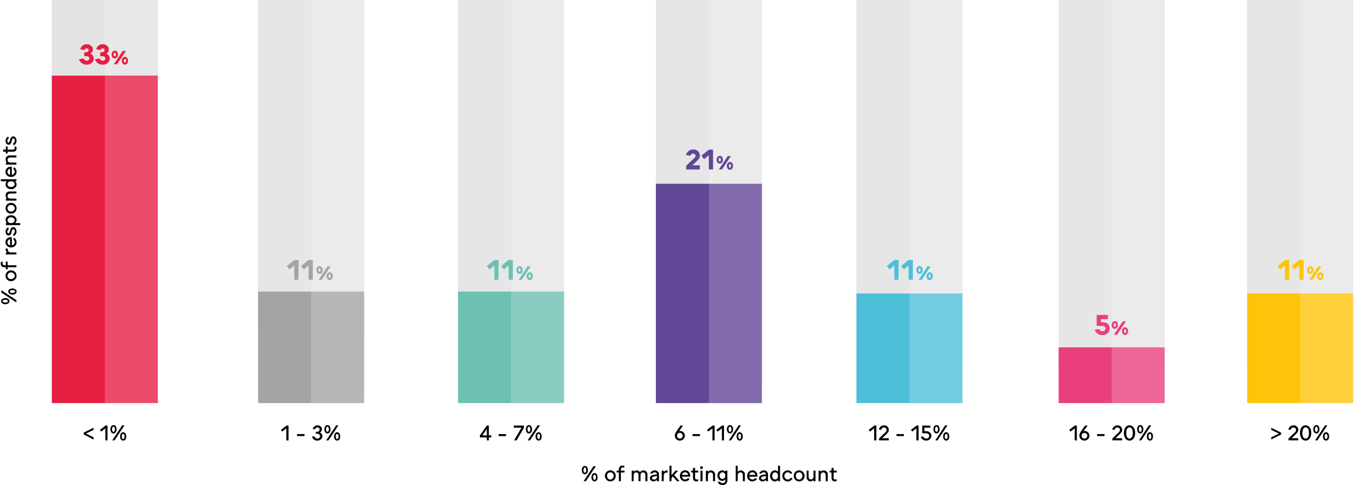
On average* the marketing operations team represents 8% of marketing’s headcount
Q: Approximately what % of your total marketing team headcount does marketing operations represent?
*Approximated weighted average based on our sample
Source: WFA & Flock online survey March 2020. Base: 30 companies
Notes:
Marketing team size as a proportion of the overall team will depend upon the functional specification of the team and the complexity of the organisation

Slide 9
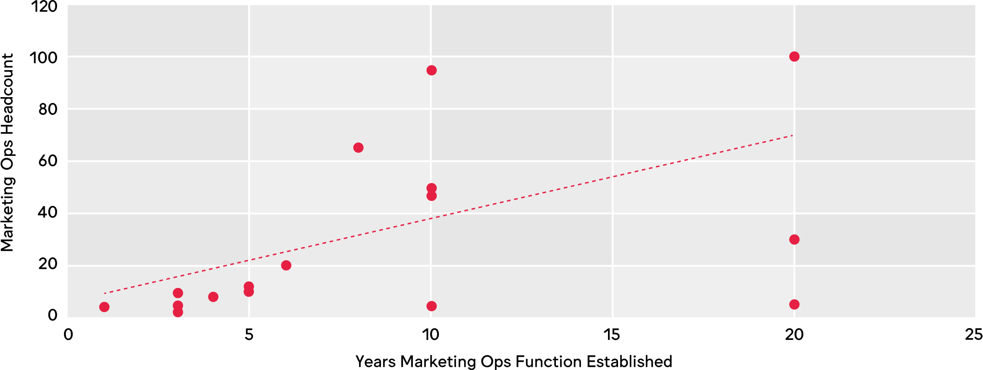
As the team matures, the headcount rises
Q: How many people work in your marketing operations department? (plotted against how many years the team has been established)
Source: WFA & Flock online survey March 2020. Resp: 19 companies
Notes:
Constant change, driven by the rapid developments in technology, media, and consumer behaviour, leads to a new level of specialisations.
Increasingly, CMOs are looking to new team structures to cope with these growing demands and therefore increase the headcount of marketing operations specialists.

Slide 10

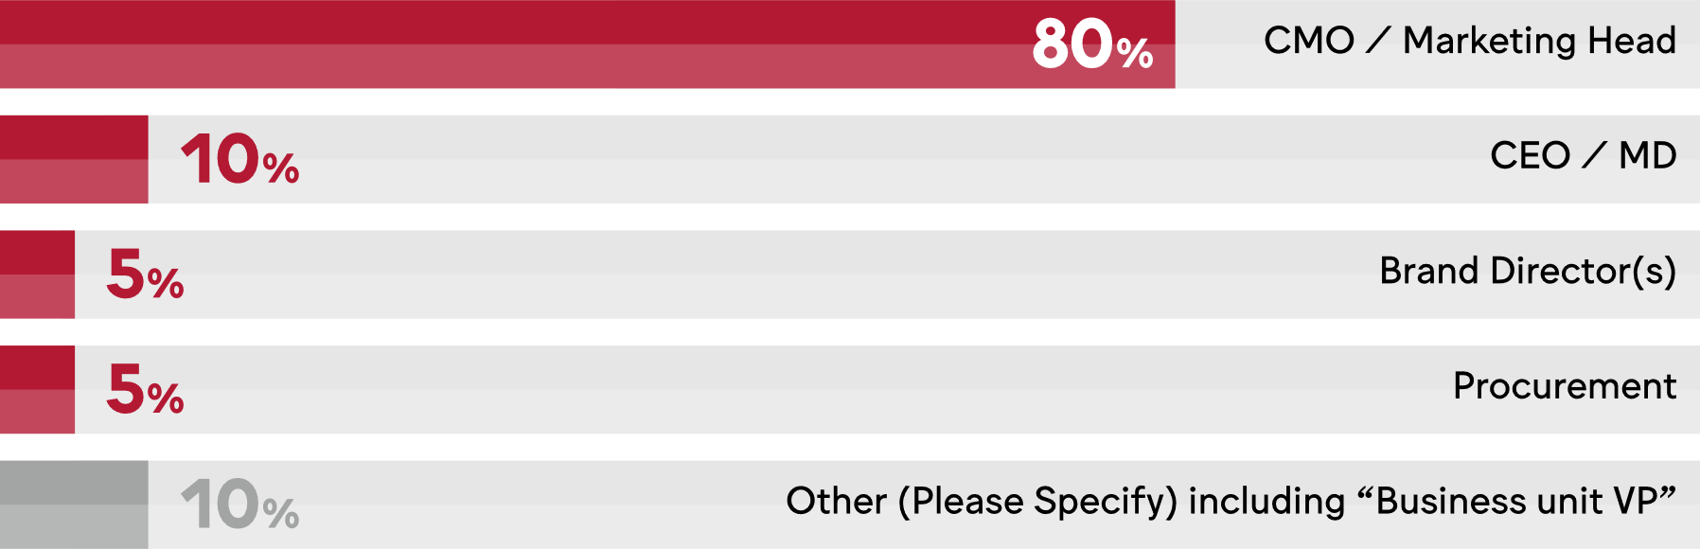
Majority report to CMO.
Q: Who does marketing operations report to in your organisation?
Source: WFA & Flock online survey March 2020. Base: 30 companies

Slide 11
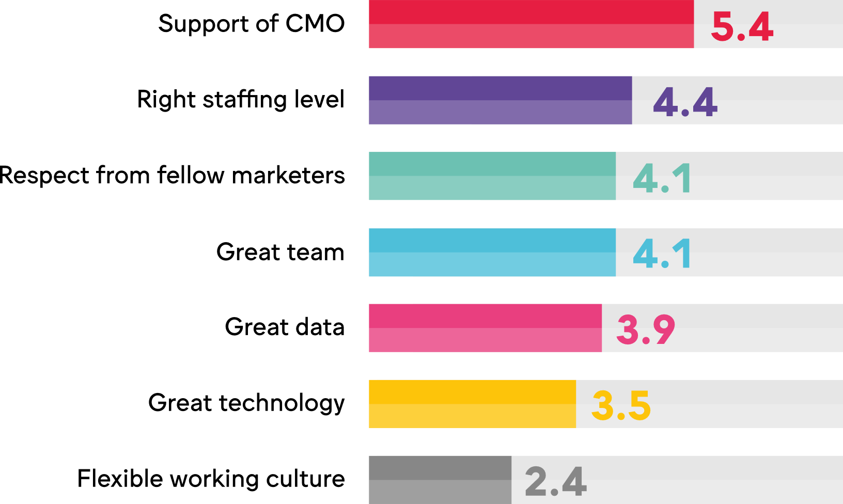
Meaning their support is critical...
Weighted average ranking / 7
Q: What do you believe are the critical enablers for a successful marketing operations team? Please rank by priority (highest priority first)
Source: WFA & Flock online survey March 2020. Base: 30 companies
Notes:
Marketing teams need to keep up with available media channels, touchpoints, adapt to changing consumer journeys in multiple markets and regions. They need to know about a huge number of platforms, tools, applications, systems, research methodologies – and the list goes on…
So it is not a surprise that the marketing operations functions sits firmly within Marketing, reporting into the CMO. This will enable the business to communicate effectively with clear reporting lines and less confusion on roles and responsibilities within the team members.
And for the marketing operations team, the leadership support from a CMO is mission critical.

Slide 12
Many critical roles for marketing ops
Q: Which of the following are included within your marketing operations remit and, if applicable, please rate their relative importance.
Source: WFA & Flock online survey March 2020. Base: 20 companies
Notes:
Agency management and setting/tracking KPIs for the agency partners is a clear focus for marketing operations teams. Often relationships and KPI’s are also linked to performance based remuneration programmes, which could be controlled by independent partners performing agency appraisals.
WFA’s agency management research showed most clients evaluate their agencies twice a year or more, with creative and media agencies being on the top of that list (60% and 57% respectively).
Without an agile process with clear roles & responsibilities and milestones marketing teams will often work in silos. Marketing operations leaders are often tasked to create new processes and are key to keep the engine running smoothly, making sure marketing initiatives stay on track, on budget and most importantly, produce better work.
Emerging trends are also the more strategic aspect of the teams responsibility, the score for marketing strategy in the secondary importance category is evidence of that.
The high result in capabilities and people development is not surprising but shows a clear trend that the marketing operations function is evolving and helping the leadership team to ensure that the marketing team is fit for the future, more data-led and truly digital - this is becoming a critical mission.
Production seems to be either integrated into the marketing operations team, or run as a separate production team, as it has high importance scores but also the highest scores for not relevant/ not applicable. In any case, close collaboration between teams will help to achieve production efficiencies.

Slide 13
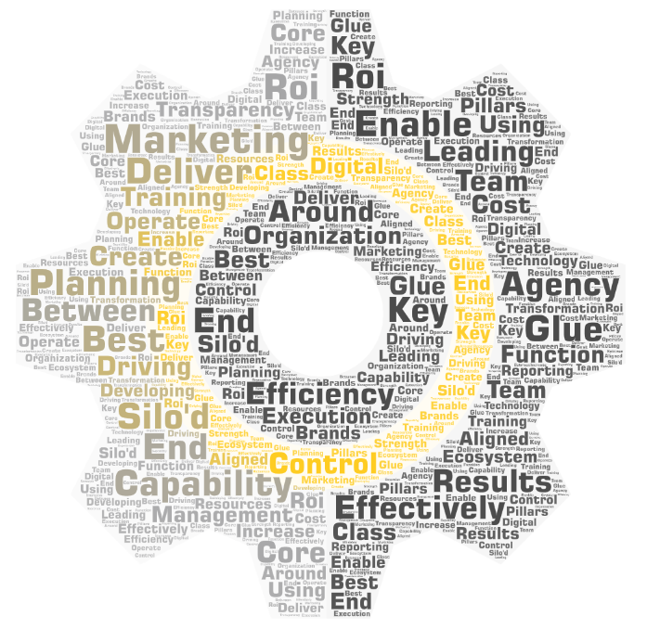
Leadership expect marketing operations “to deliver results”
“
Leading planning, agency management and capability training
The glue between our silo'd organization
Driving control, transparency, and efficiency around planning and execution
To enable the function to operate effectively
To create an end to end ecosystem by developing team digital capabilities and using technology to increase marketing ROI and reporting capabilities.
Resources that are aligned with the core pillars of Marketing transformation and are a key enabler of the strength of the Marketing Organization
Enable marketing effectiveness and efficiency
Deliver best in class marketing capabilities for all the brands - best effectiveness at best cost.
Q: Please share your senior leadership’s expectations relating to the role of marketing operations?
Source: WFA & Flock online survey March 2020. Base: 30 companies
Note: above shows a sample of responses

Slide 14
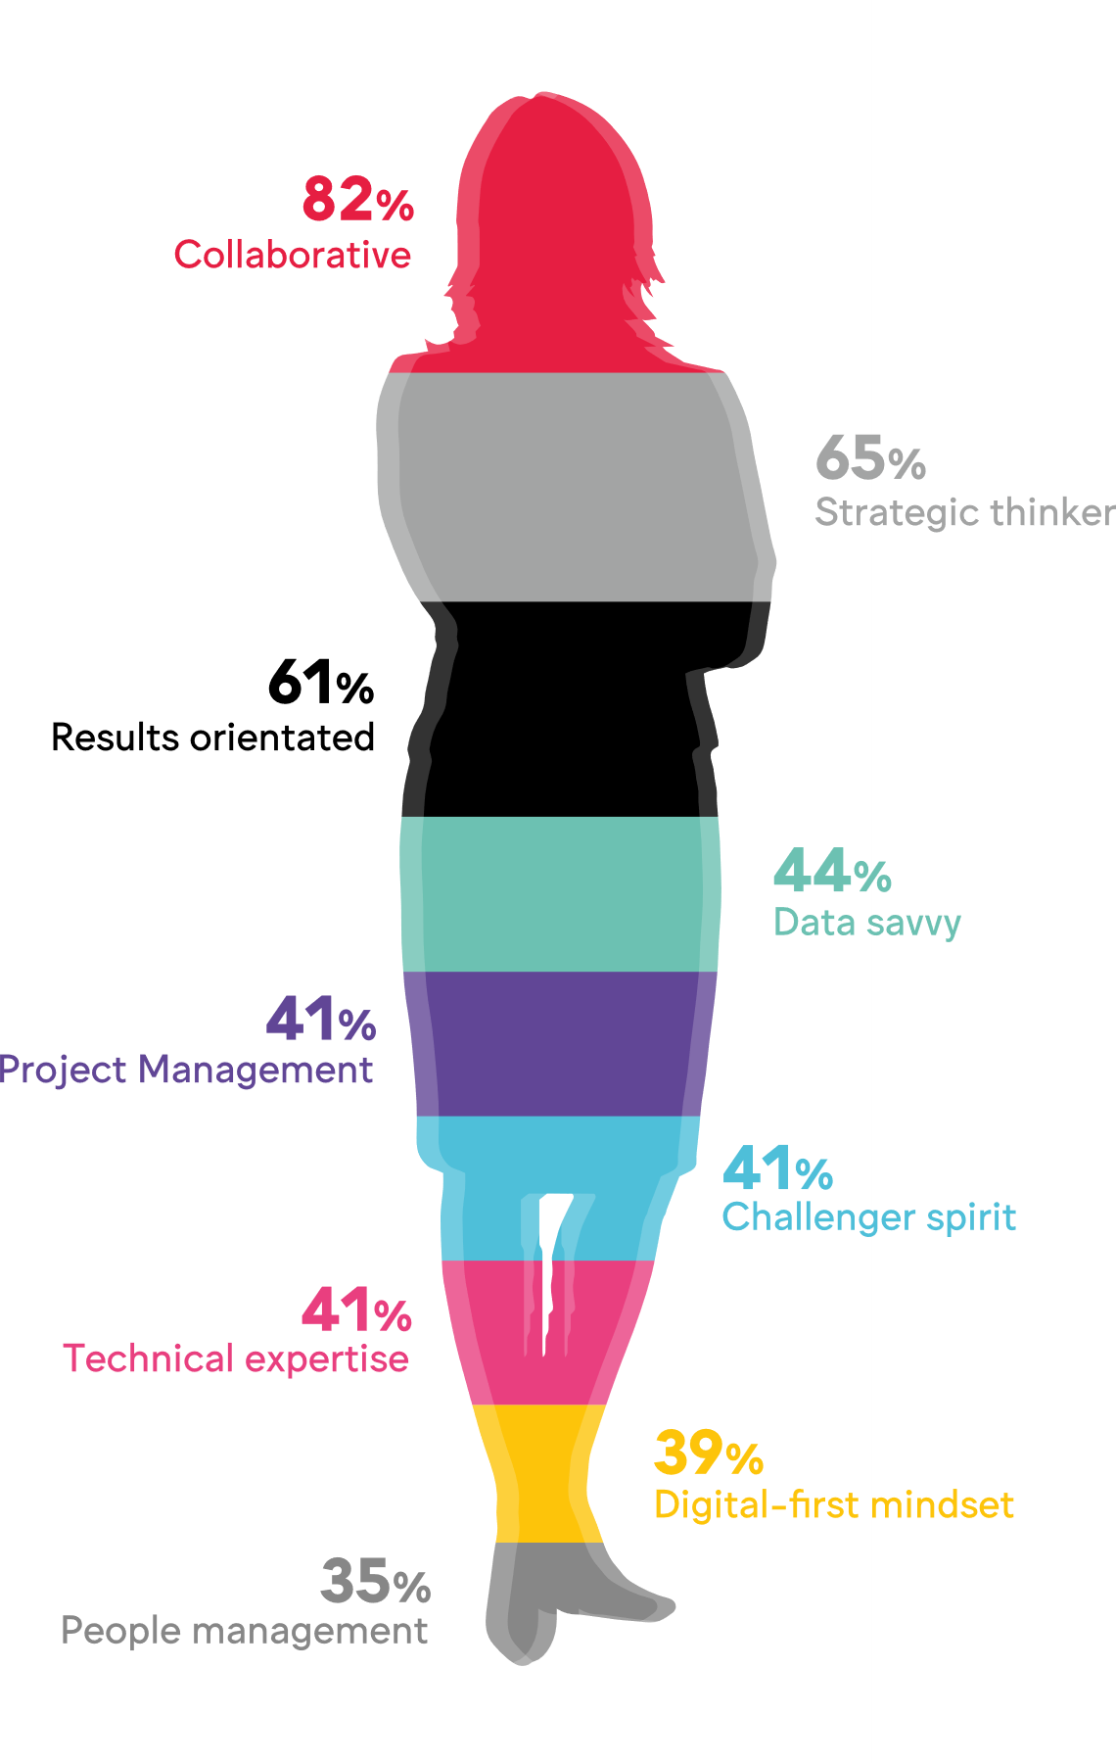
Collaboration key for marketing operations
How important are the following skills and competencies in marketing operations?
Shows top (8) selection of ‘critical’ only
Source: WFA & Flock online survey March 2020. Base: 20 companies. Shows critical and important scores combined.

Slide 15

Route IN to marketing operations?
Agency “Agency background” Agency background with martech company experience” “Agency” “Agency or direct relationship working with agencies and managing campaigns and projects. Agency” “agency production, consulting” | Marketing “Some in local marketing want to do a new global role without a focus on local sales targets” “Marketing, programme management, business operations” “Marketing, marketing finance, agency operations”
Graduates “Hire from university - like all the functions in [our company]” “Graduate hires from marketing, psychology, engineering, finance and computer science. | Other “I do not see procurement as a path. You cannot be solely dollar or budget focused in this role. The importance here is a broad set of marketing skills.” “Brand Management”
Q: In your opinion, what is the most likely career path IN to Marketing Operations
Source: WFA & Flock online survey March 2020. Base: 30 companies

Slide 16
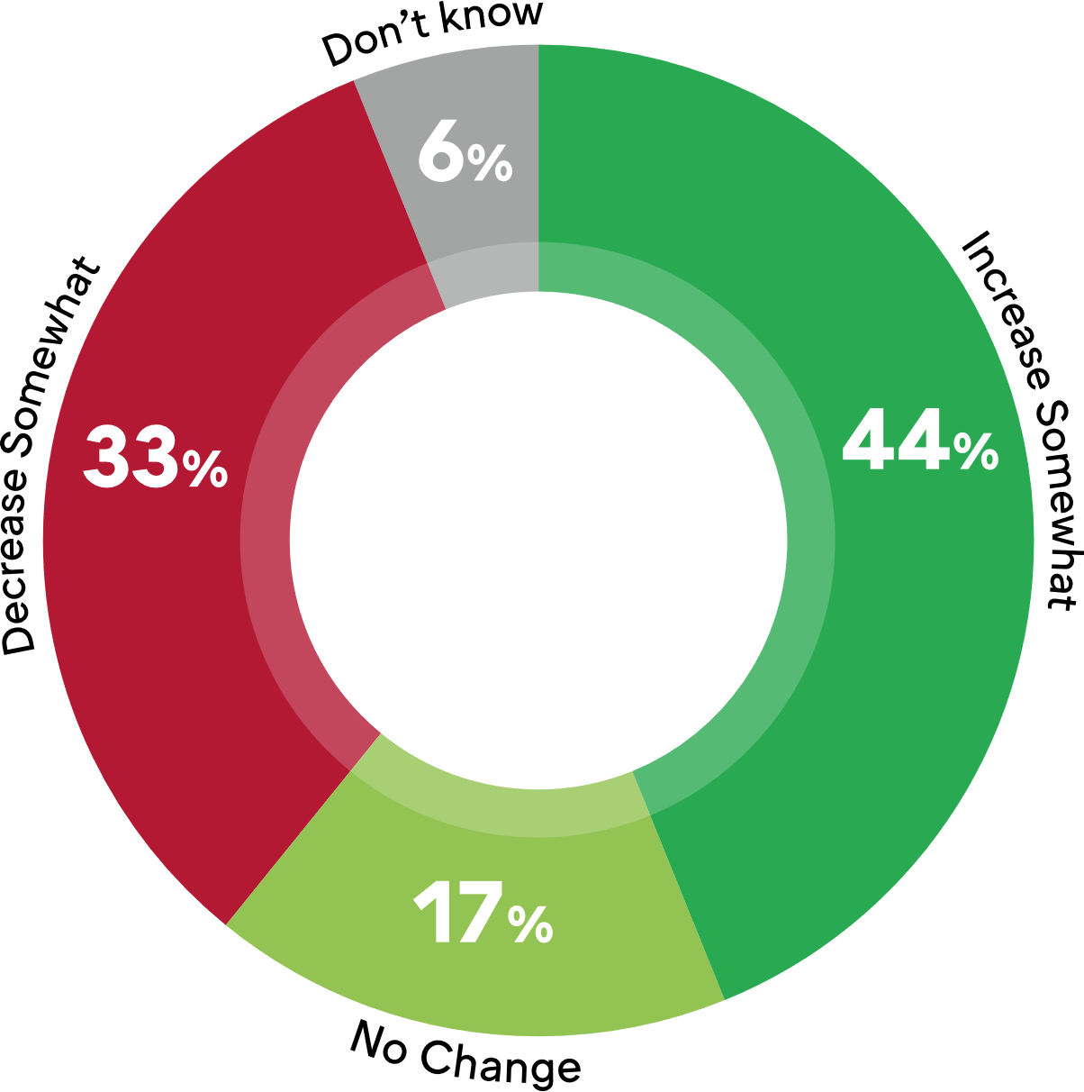
Future investment curve fairly flat
Q: Do you expect to increase investment in marketing operations over the next 3 years?
Source: WFA & Flock online survey March 2020. Base: 30 companies. Note: no respondents said ‘decrease significantly or ‘increase significantly’
Notes:
Once established, we have seen from our headcount analysis; as teams mature they grow. However, in the current economic climate in the short term the overall projection of investment in this function is flat.

Slide 17

Challenges facing the function
External ecosystem “Changing agency landscape" “The digital evolution and complexity of the ecosystem ( agency, publishers, martech, OTT, GAFA) and the customer interest and attention" “Challenges to sourcing in global regions such as China and HK, and need to diversify supplier base; Staying on top of changing tech/innovations" | Internal organisation “Internal challenges around alignment across a decentralized organization more for less" “Organizations tend to dump non-strategic, repetitive manual tasks to marketing operations." “Building team capabilities, and data limitations in the region."
Data and tech “Data Privacy. The higher the walls that Google and Facebook are building" “Belief in value delivered" “Supporting the function in becoming more digitally, data driven and cost effective" “The pace of change is so large … GDPR, Tech stack, multiple brands... | Legacy approaches “Agile planning and execution within long, established campaigns" “How to balance across the traditional and non-traditional needs within marketing"
Q: In your opinion, what is the most likely career path IN to Marketing Operations
Source: WFA & Flock online survey March 2020. Base: 30 companies
Notes:
The quickly evolving innovations in technologies are challenging businesses to identify which technologies and tools are needed. Businesses are conducting gap assessments on current skill sets and technologies within the business to help to define what is required for a future-fit marketing organisation.
The agency landscape is always evolving and an internal review of the current agency ecosystem and respective contracts will help to optimise a future agency ecosystem that is fit for purpose.
[Flock Callout box with their logo] One of the biggest challenges Marketing Operations teams are facing is with legacy structures and processes. Changing ways of working and implementing more agile and effective processes, could, in some cases, lead to an estimated 15% reduction in meetings and 25% reduction time spent in meetings per campaign (Flock research)

Slide 18
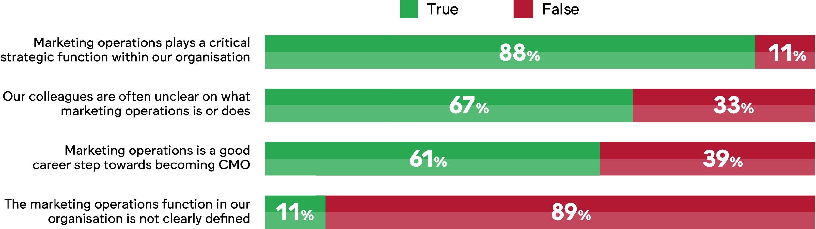
A critical role, well defined, but perhaps not clearly communicated
Q: True or false?
Source: WFA & Flock online survey March 2020. Base: 30 companies

Slide 19
Flock’s top tips for marketing operations
Processes: Understand your existing processes, structures, tools and technology. Once you understand what capabilities you currently have, you can start to visualise where you want/ need to be in two or three years to stand out from your competitors. To help you to frame where you want to be, review your customer experience. Do you have a full overview of your customer journey? Are you building customer feedback and insight into your marketing processes as well as team and agency appraisals, or is it a once a year thing that sits on a shelf? What should your customer experience look and feel like? Re-engineer your processes based on your vision and the customer needs, not on yours.
Standardisation & technology: Exceptional marketing processes are essential. By creating standardised templates and effectively using technology it will give creatives more time to focus on what they are brilliant at and release funds to invest back into the brand. With the continued emergence of different communication & commerce channels, creatives are getting swamped by day to day operational issues
Skills Assessment: Especially in the current situation with COVID-19, many advertisers are accelerating plans for their marketing skills assessment to identify a combination of the technical & team marketing skills and marketing infrastructure (like technology and data) that you need to win in today's and tomorrow’s competitive environment.
People: You must provide the right environment where evolving and learning are central to your values. Talent is the platform of all businesses, so it is vital to attract and retain the right people. This is not just for creatives but for Marketing operations professionals too. Think about ways you can make Marketing Operations, the environment, and the tools we use, cool!
Agency ecosystem: Wherever you are on your journey with your agency partners, always align with all your internal stakeholders and review what marketing functions should be delivering inhouse and what you should outsource to external partners. Sounds obvious but it is a pitfall we have seen many people fall into and therefore they have found marketing transformation almost impossible.
Data risk mitigation: GDPR is the first of many data initiatives that will impact our business. Get under the skin of how they will affect you and how you set yourselves up for success to benefit from these changes. Don’t lose sight of your legal obligations and the restrictions around content usage and licensing, especially as we continue to use new content sources including UGC

Slide 20
Recommended consultants
Our partner for this Survey was Flock Associates https://www.flock-associates.com/, however we also asked for consultants used by members.
Media Link, https://medialink.com/
MightyHive, https://mightyhive.com/
55, https://www.fifty-five.com/
Ekimetrics, https://www.ekimetrics.com/
Artifact, https://www.artefact.com/
Equancy http://www.equancy.fr/en/home
PWC, https://www.pwc.co.uk/services/consulting.html
Note: WFA is happy to pass on members’ experiences and/or recommendations. Please note that any such experiences and/or recommendations do not reflect WFA's position and should not be considered as WFA's experiences and/or recommendations. In particular WFA does not undertake any investigations or make any judgments on the quality or the performance of any agency and does not take any responsibility for the accuracy of experiences and/or recommendations expressed by its members.
Q: Final (optional) question: Can you name any marketing transformation/operations/services consultants you know and would recommend?
Source: WFA & Flock online survey March 2020. Base: 30 companies

Slide 21

For more information
Robert Dreblow, WFA r.dreblow@wfanet.org
Florian Voigt, Flock Associates florian.voigt@flock-associates.com
Note: All benchmarks, survey results, agendas and minutes are reviewed by Hogan Lovells International LLP, our competition lawyers
WFA Competition law compliance policy
The purpose of the WFA is to represent the interests of advertisers and to act as a forum for legitimate contacts between members of the advertising industry. It is obviously the policy of the WFA that it will not be used by any company to further any anti-competitive or collusive conduct, or to engage in other activities that could violate any antitrust or competition law, regulation, rule or directives of any country or otherwise impair full and fair competition. The WFA carries out regular checks to make sure that this policy is being strictly adhered to. As a condition of membership, members of the WFA acknowledge that their membership of the WFA is subject to the competition law rules and they agree to comply fully with those laws. Members agree that they will not use the WFA, directly or indirectly, (a) to reach or attempt to reach agreements or understandings with one or more of their competitors, (b) to obtain or attempt to obtain, or exchange or attempt to exchange, confidential or proprietary information regarding any other company other than in the context of a bona fide business or (c) to further any anti-competitive or collusive conduct, or to engage in other activities that could violate any antitrust or competition law, regulation, rule or directives of any country or otherwise impair full and fair competition.

