Slide 1
STRATEGIC SONIC BRANDING IS URGENT
Do good with marketing via sound

Slide 2
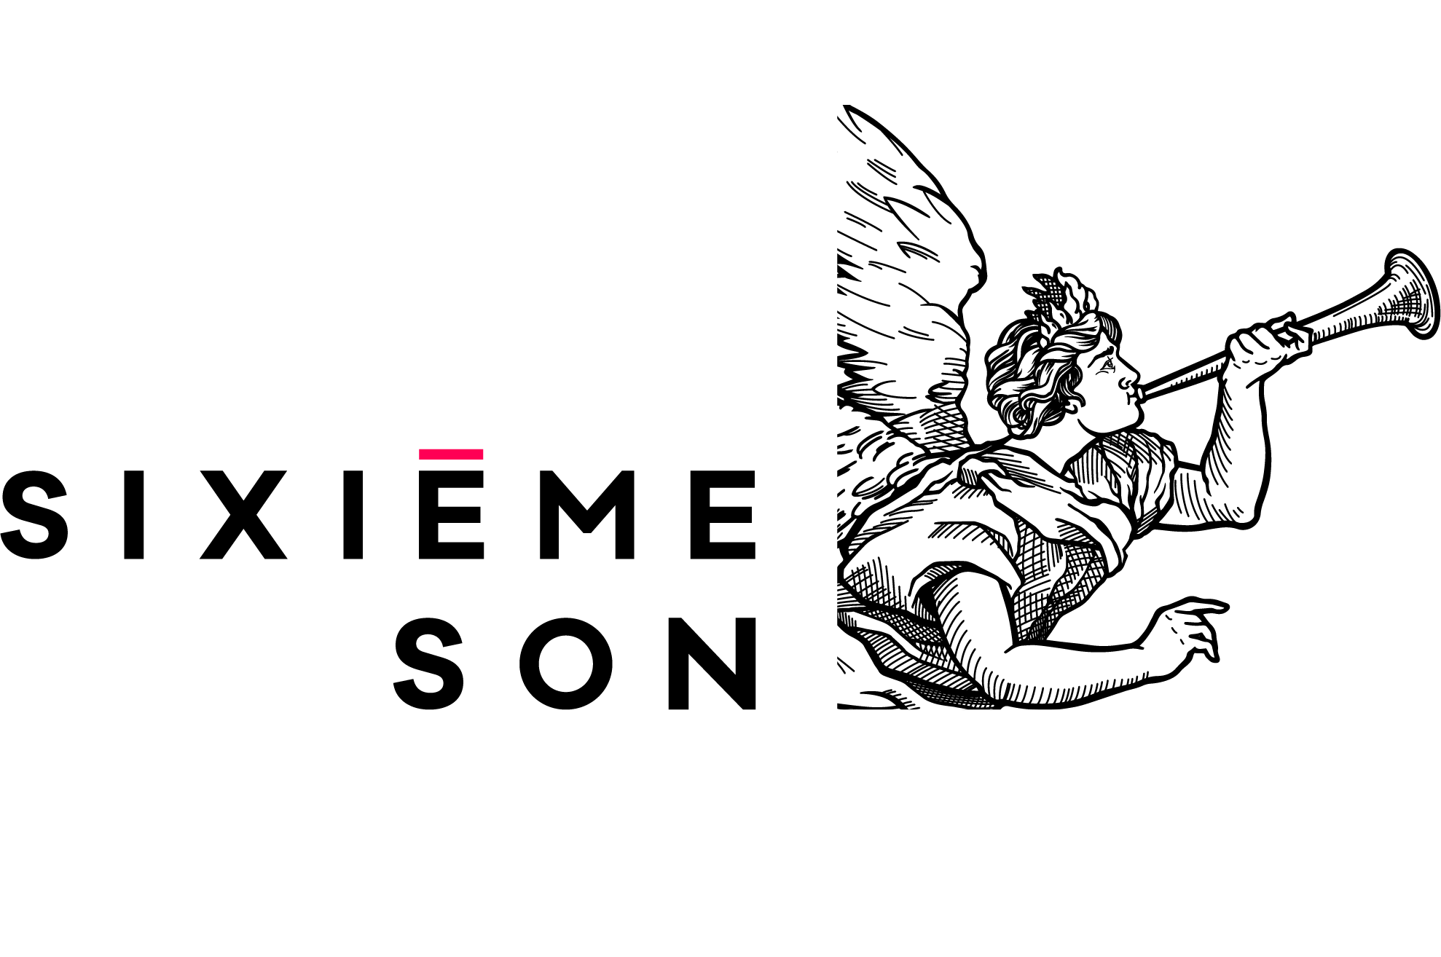
ABOUT SIXIÈME SON
Pioneer and leader in sonic brand design
World leader in sonic branding, designer and strategists for more than 400 Sonic Brands
Over 24 years of exclusive sonic experience; founded in 1995
Global presence : offices in Paris, New York, Sydney, Toronto, Barcelona and Moscow; partners in Turkey and UAE
Awards:
  Grand Prize Strategy and Super Design Prize 2010, 2011, 2012, 2013, 2014, 2015, 2016. In 2017 Sixième Son, Gold, Silver & Bronze
  Sonic Branding Award Best Case 2013, 2015
  Transform Awards NYC 2016 & 2018

Slide 3


SOUNDS SET THE TONE.

Slide 4
SOUNDS SET THE TONE
Perception, emotion, unconscious behavior
GENERAL UNIVERSAL SOUNDS THAT IMPACT OUR EMOTIONAL RESPONSE:
Alarms (ambulances, police, morning, fire detector, timer, etc.)
Train whistles
Nature sounds (can be both positive and negative)
Laughter
Crowd cheering
Faucet drip
Mac or Windows startup

Slide 5

WHAT DOES SONIC MEAN FOR BRANDS?

Slide 6


WHAT DOES SONIC MEAN FOR BRANDS?
    SOUND IMPACTS THE UNDERSTANDING OF VISUAL MARKETING

Slide 7
WHAT DOES SONIC MEAN FOR BRANDS?
    IN A SCREENLESS WORLD, SOUND IS THE GATEWAY TO:
    Convey brand experience and culture
    Generate brand value
    Customer experience and brand interaction

Slide 8
SONIC BRANDING IS URGENT

Slide 9
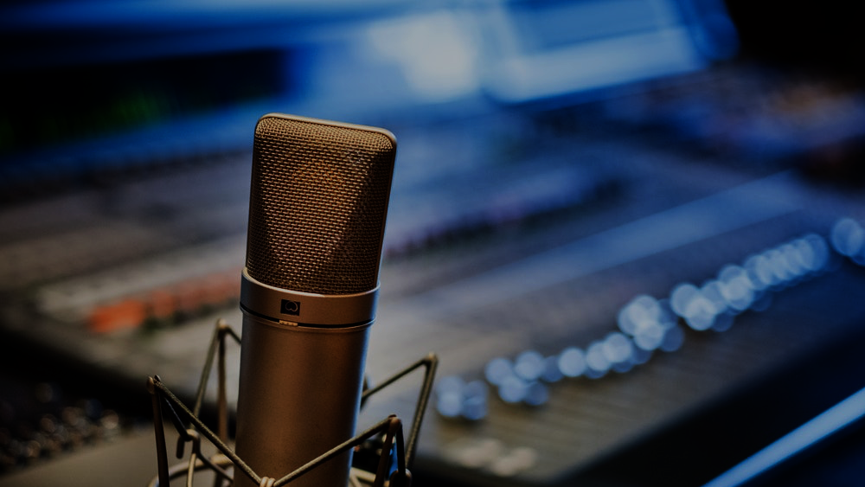
DESIGNING A
SONIC BRAND IDENTITY.

Slide 10

THANK YOU.

